Slide 1
N.JAYACHITRA ME CSE EXPLORTORY DATA ANLAYSIS
& MACHINE LEARNING PRECTION

Slide 2

UBER DATA ANALASIS PRECTION
1.EXPLORATORY DATA ANLAYSIS
2.DATA PREPROSSING
3.DATA VISUALITION
4.MACHINE LEARNING
5.LOGISTIC ALOGORITHM & PRECTION
6.CONCLUSION

Slide 3
EXPLOTARY DATA ANALYSIS
Exploratory Data Analysis (EDA) is an approach to analyze the data using visual techniques.
It is used to discover trends, patterns, or to check assumptions with the help of statistical summary and graphical representations.
Getting a better understanding of data 2 Identifying various data patterns 3 Getting a better understanding of the problem statement

Slide 4
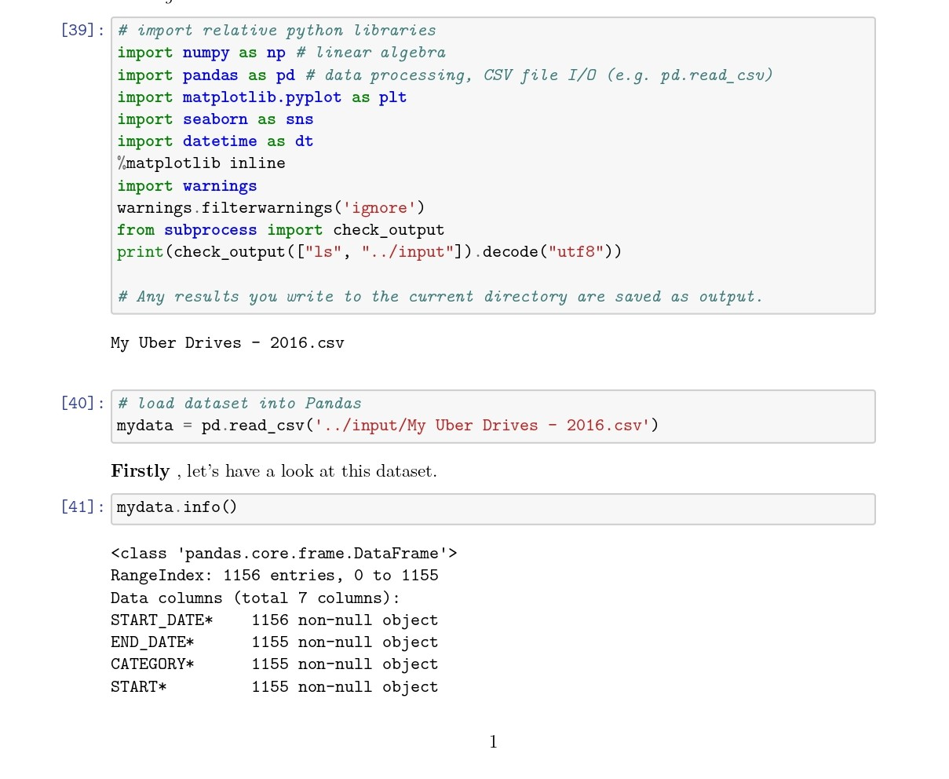
Exploratory Data Analysis

Slide 5
DATA PREPROCESSING
Data preprocessing, a component of data preparation, describes any type of processing performed on raw data to prepare it for another data processing procedure.
It has traditionally been an important preliminary step for the data mining process.
Load data in Pandas.
Drop columns that aren't useful.
Create dummy variables.
Take care of missing data.

Slide 6
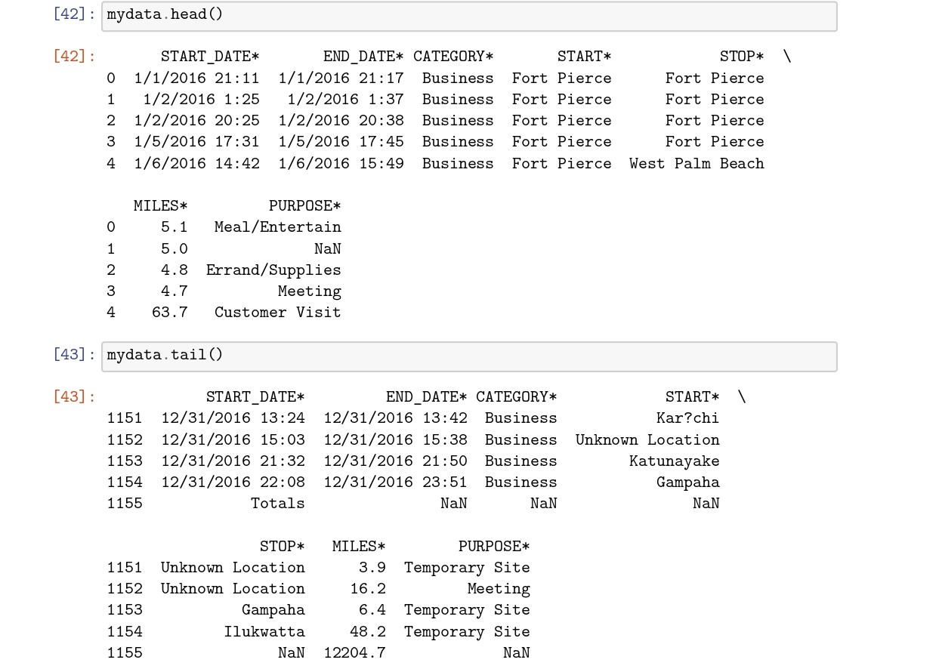
DATA PREPROSSING

Slide 7
DATA VISUALITION
Data visualization is defined as a graphical representation that contains the information and the data.
By using visual elements like charts, graphs, and maps, data visualization techniques provide an accessible way to see and understand trends, outliers, and patterns in data.
The main goal of data visualization is to make it easier to identify patterns, trends and outliers in large data sets.

Slide 8
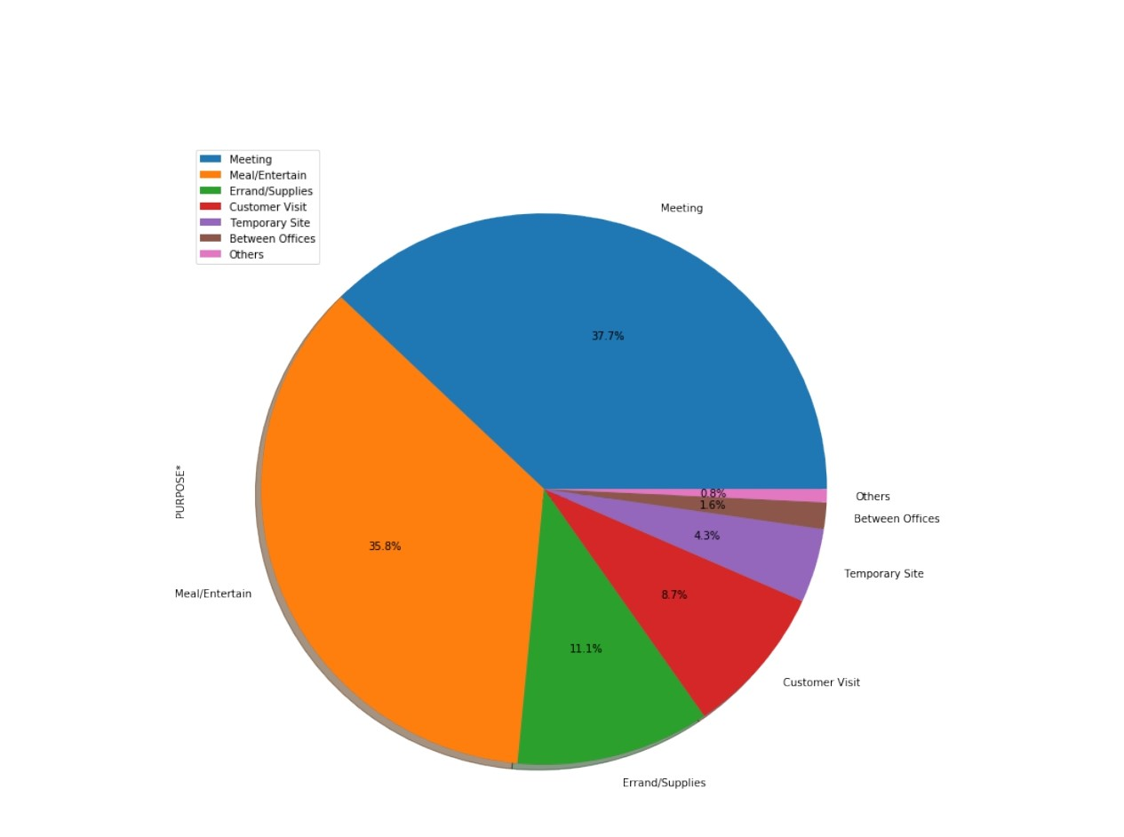
DATA VISUALATION
Uber data analaysis category wise

Slide 9
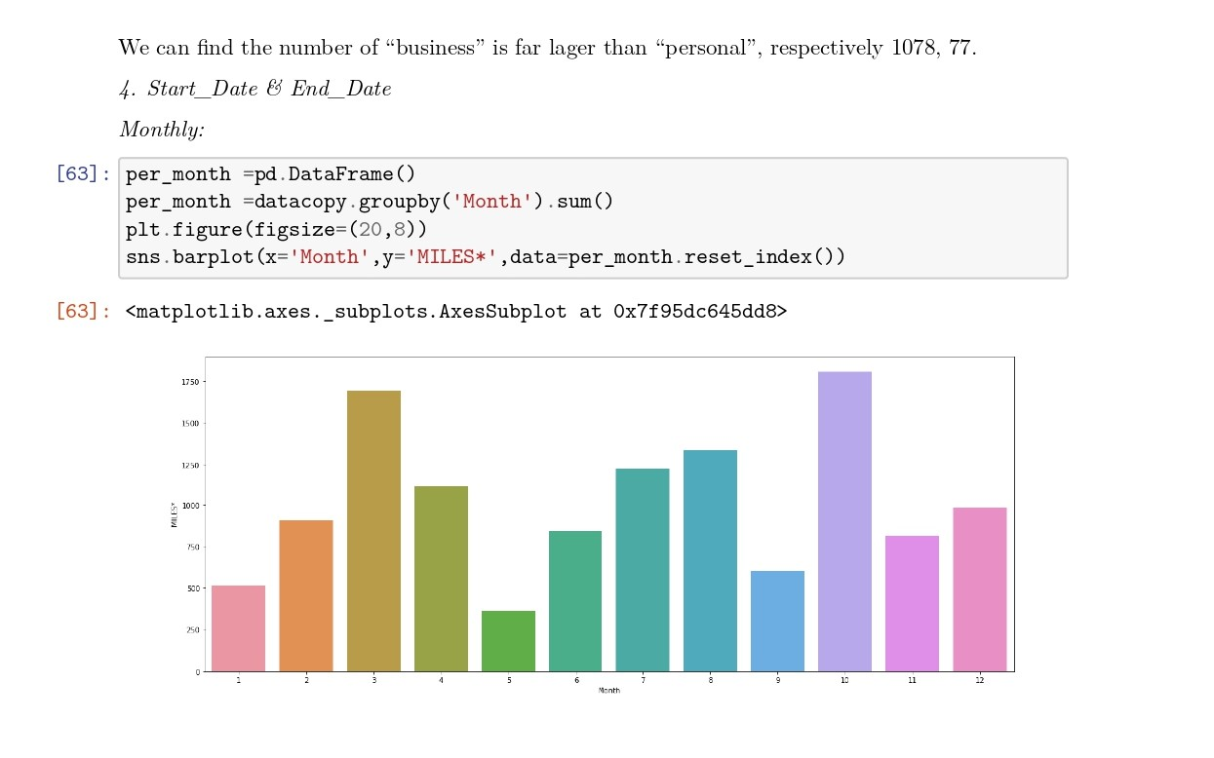
DATA VISUALITON uber data analysis visualition

Slide 10
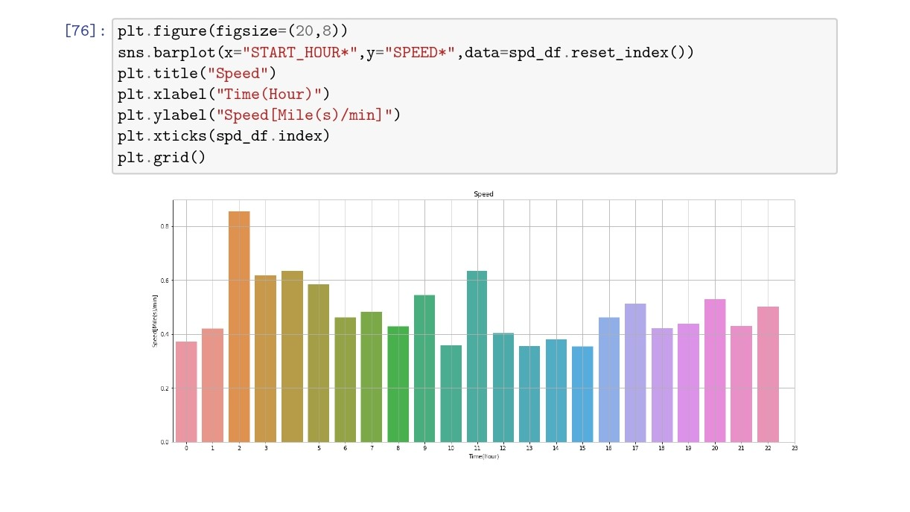
DATA VISUALITION Uber data anlayasis

Slide 11
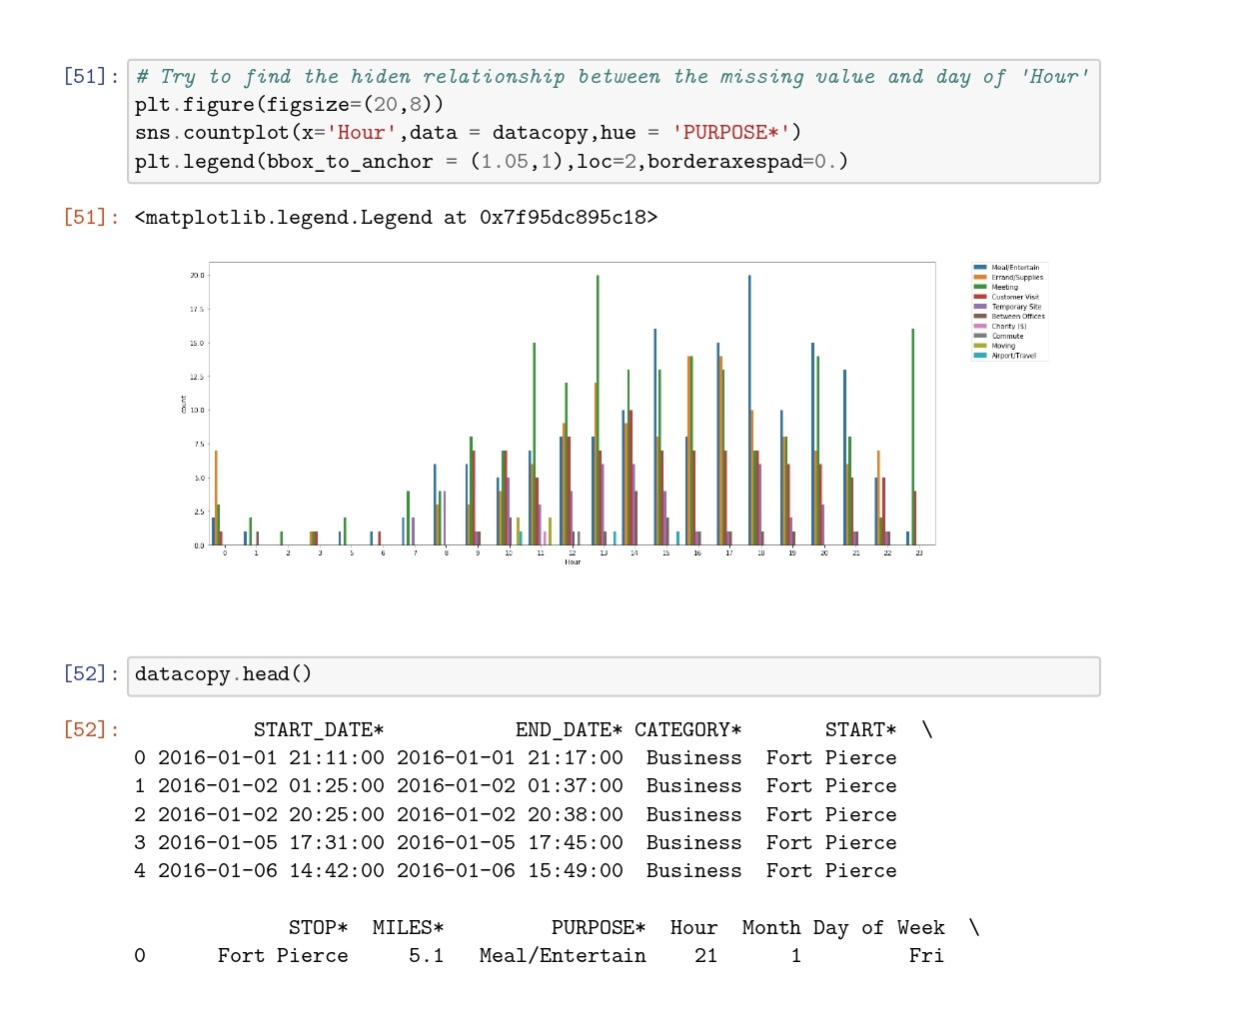
Category in Uber data analysis

Slide 12
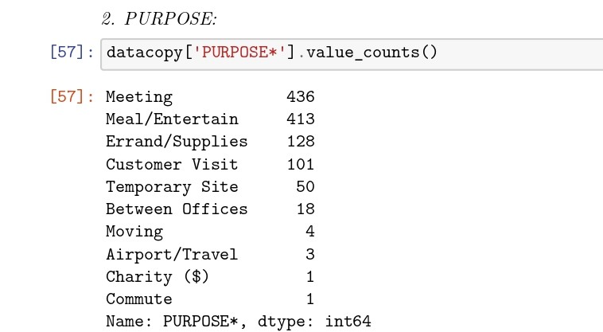
Uber Data purpose data

Slide 13
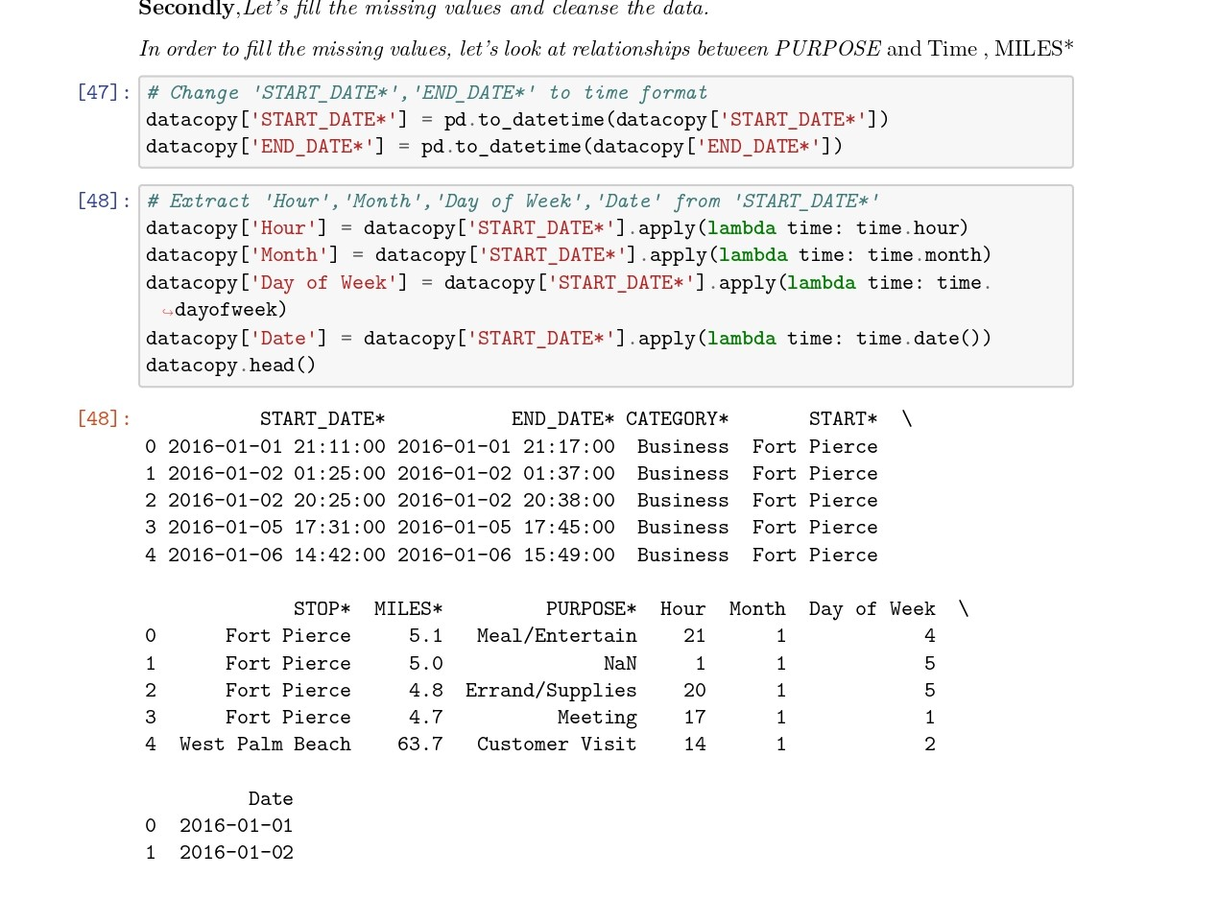
Uber Data date and month wise

Slide 14
MACHINE LEARNING
Machine Learning is making the computer learn from studying data and statistics.
Machine Learning is a step into the direction of artificial intelligence (AI).
Machine Learning is a program that analyses data and learns to predict the outcome.

Slide 15
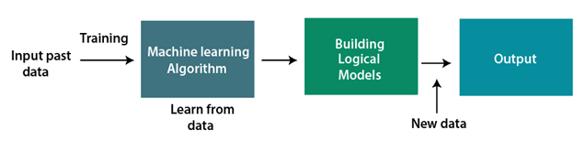
MACHINE LEARNING WORK

Slide 16
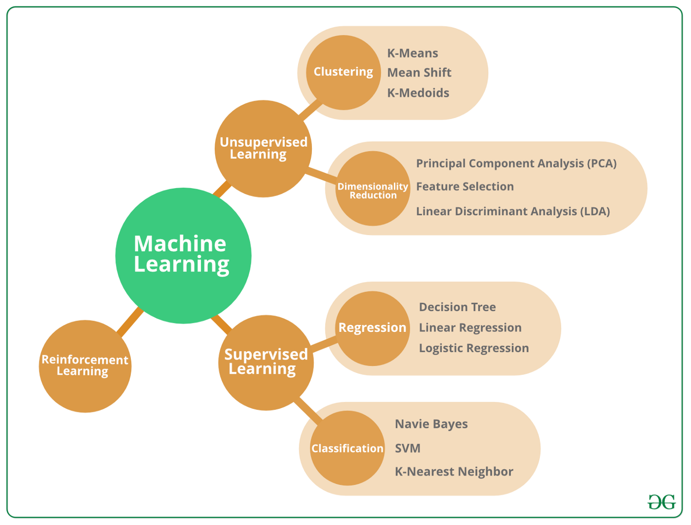
TYPES OF ML
There is a 3 Types

Slide 17
Logistic regression machine learning
Logistic regression is one of the most popular Machine Learning algorithms, which comes under the Supervised Learning technique.
It is used for predicting the categorical dependent variable using a given set of independent variables.
Logistic regression predicts the output of a categorical dependent variable.

Slide 18
Logistic Regression
Logistic regression is a statistical analysis method to predict a binary outcome, such as yes or no, based on prior observations of a data set.
A logistic regression model predicts a dependent data variable by analyzing the relationship between one or more existing independent variables.
Logistic regression is used across many scientific fields.

Slide 19
Logistic regression Steps
Model the building
Plot Precision vs Recall curve
Test accuracy of the result(Creation of Confusion matrix)
Visualizing the test set result.

Slide 20
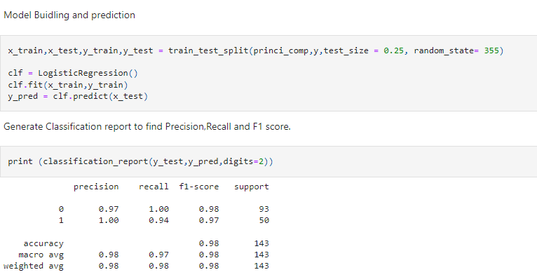
Model The Buliding
Perform machine learning optimisation.
Deploy the model.

Slide 21
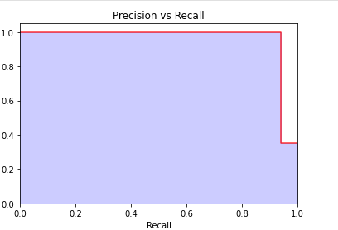
. Plot Precision vs Recall curve
It is important to note that Precision is also called the Positive Predictive Value (PPV).
Recall is also called Sensitivity, Hit Rate or True Positive Rate (TPR).

Slide 22
Test accuracy of the result(Creation of Confusion matrix)
A confusion matrix is a table that is used to define the performance of a classification algorithm.
A confusion matrix visualizes and summarizes the performance of a classification algorithm
Given is an example to know the terms
True Positive, True Negative, False Negative, and True Negative. True Positive: You projected positive and its turn out to be true.

Slide 23
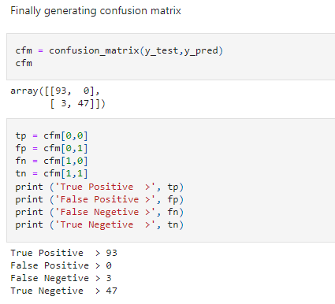
Test accuracy of the result(Creation of Confusion matrix)

Slide 24
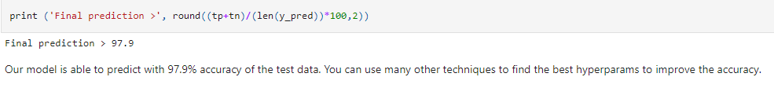
Visualizing the test set result

Slide 25
CONCLUSION
One possible cause might be that precipitation might have reduced the freeway capacity but the trip demand to use the freeway has not decreased accordingly. The limitation to our system comes mainly from the data that we have obtained. Uber Movement data d oes not contain all the necessary information that could have made our predictive model more realistic, or could have outputted result more precise to urban planning. Uber Movement does not contain the following data that we think could have helped our cause better. The route taken by the Uber trips. The width and the traffic flow and density. The number of trips made between every node per day.
.

Slide 26


